Slide 1


MARKETING
ANALYSIS

Slide 2

TABLE OF CONTENTS
1
Introduction
2
recomended analysis
3
Conclusion
4
Contact

Slide 3

INTRODUCTION
Maven Marketing possesses detailed data from a recent marketing campaign involving 2,240 customers. This dataset includes comprehensive customer profiles, product preferences, campaign outcomes (successes and failures), and channel performance metrics. The challenge is to analyze this dataset effectively to derive actionable insights that Maven Marketing can utilize to optimize future marketing strategies

Slide 4

Q1 ARE THERE ANY NULL VALUES OR OUTLIERS?HOW WILL YOU HANDLE THEM?
Yes, there were 24 null values in income column which where replaced by mean of all salaries. Also there were outliers in the marital status column and they were replaced with appropriate options. YOLO, Absurd , Alone were replaced with Single . And Together was replaced by Married.

Slide 5
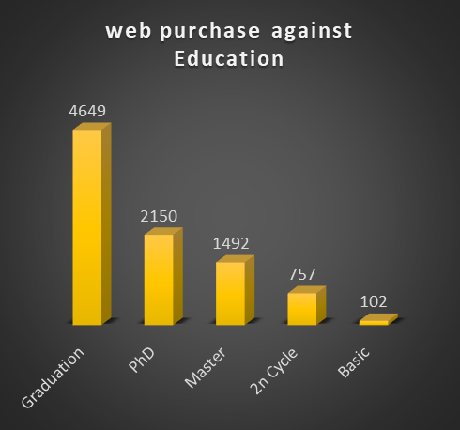
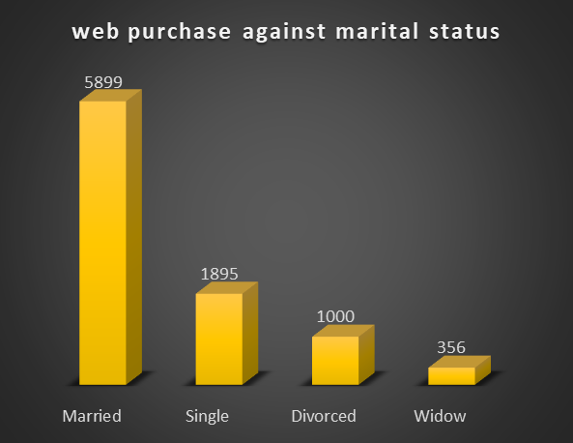
Q2. WHAT FACTORS ARE SIGNIFICANTLY RELATED TO THE NUMBER OF WEB PURCHASES?
It is observed that Graduated and Married people are more in number for the web purchase.

Slide 6
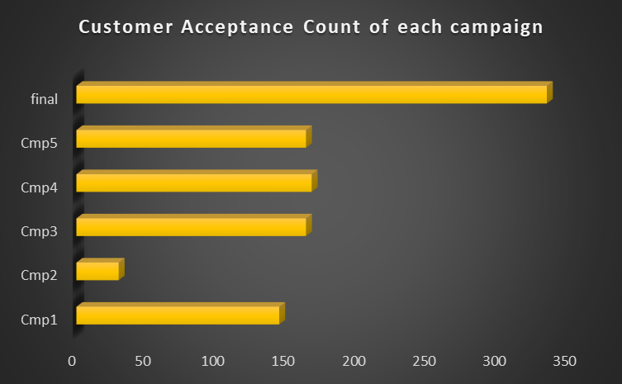
Q3. WHICH MARKETING CAMPAIGN WAS THE MOST SUCCESSFUL?
It is observed that most number of people accepted the offer in the 6th campaign. So it can be said that Last campaign was the Most succesful one.

Slide 7
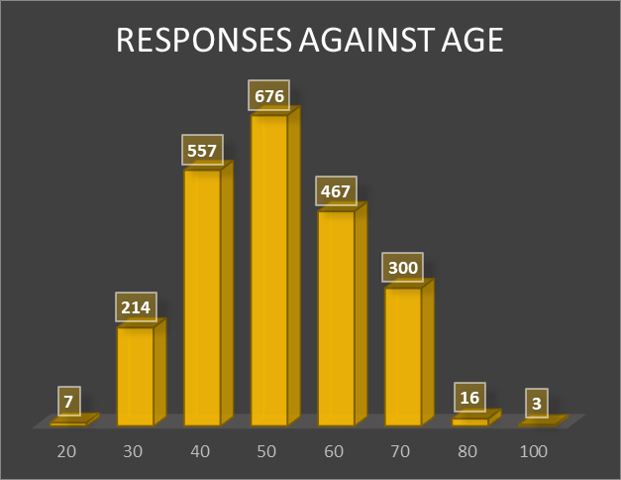
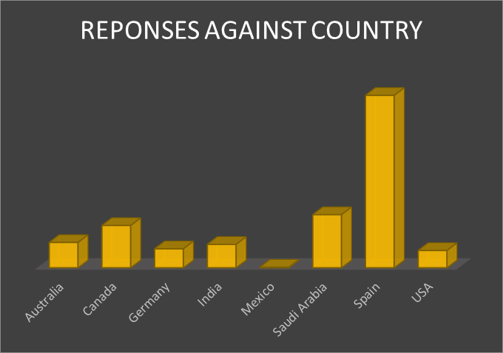
4. WHAT DOES THE AVERAGE CUSTOMER LOOK LIKE?
From analysis it can be said that an average customer can be a graduate, married who is in his 50s and lives in spain.

Slide 8
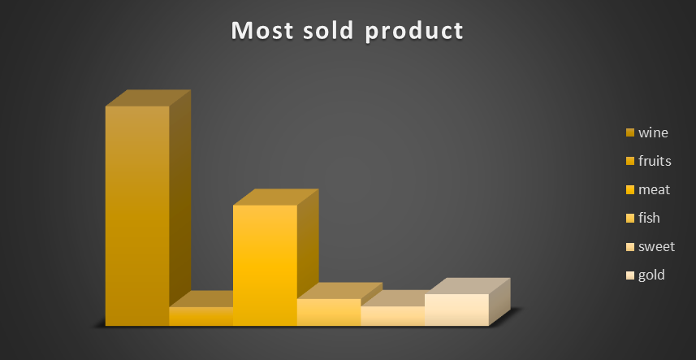
Q5. WHICH PRODUCTS ARE PERFORMING BEST?
Wine is the best performing product followed by meat and gold.

Slide 9
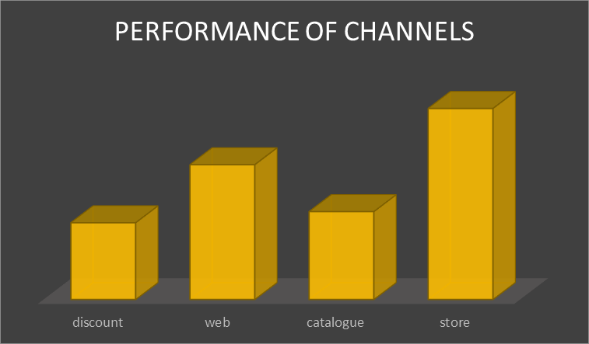
Q6. WHICH CHANNELS ARE UNDERPERFORMING?
People do not prefer to shop with a discount or using catalogue.

Slide 10
CONCLUSION
Analysis
Suggestions
It is found that among the six campaigns last or the final campaign was the most successful one. Most of the products were sold on web. And most of the customers are married, graduate, live in spain. And the most sold product is wine.
The company must focus more on married and graduate people and their product satisfaction so that the sales increases. Products other than wine needs to be advertised to increase their sales. Also people living in spain should be targetted with more ads.

Slide 11
Project Owner : Samiksha Jagne
LinkedIn : https://www.linkedin.com/in/samiksha-jagne/
Github : https://github.com/samikshajagne
Peerlist : https://peerlist.io/samiksha_jagne
Contact : samikshajagne2@gmail.com
Do not hesitate to contact if you have any doubts regarding the analysis.
THANK
YOU!

